Slide 1


SEICHE 2022 Introduction to Arduino FINAL Lesson 10/11/12 – Smart LED Strips, Flashing software binaries, WLED
Instructor: Paul Frommeyer
www.paulfrommeyer.com
Corporate Sponsor: DXC Technology

Slide 2
GUESS WHAT?
YOU DON’T HAVE TO COPY ANYTHING TODAY!
Y’all are keeping your flash drives, and the only thing that has been updated is this presentation.
Updated files are in the Lesson 10-11-12 folder on your flash drives. I have included the BOM for the lamp I made. Enjoy!

Slide 3
Lesson Plan Overview
Lesson 1 – Intro and Setup
[may require 2 classes]
• Introduction to class format
• Overview of lesson plan
• Presentation format (monitor, camera, screen, whiteboard)
• Inventory of Arduino kits
• Inventory of USB drives
• Installation of ESP32 serial port drivers (Windows only)
• Installation of Arduino software
• History of Computing
Lesson 2 and 3 – Laptop operation review
• Control panel/Settings location
• Home directories and folder hierarchy
• Arduino file locations
• Search functions
• Open questions and issues
• History of Computing redux
Lesson 4 and 5 – IDE essentials
• The boards manager
• Setting board type
• Installing Libraries
• Loading example sketches
• Finding and selecting the Arduino USB port
• Uploading a sketch to the microcontroller [Example Sketch#1]
• Basic Arduino sketch (program) structure
• Uploading your own sketch [Class Sketch #2]
• History of Telecommunications and Networking – Part 1
Lesson 6 – DC Electricity Basics and DMM Intro
• Quick review: DC vs AC electric currents
• DC current operation
• Voltage vs Amperage (current)
• Ohm’s Law
• Series vs parallel circuits
• Introduction to basic DMM functions and usage
• Measuring voltage [DMM usage #1]
• History of Telecommunications and Networking – Part 2
Lesson 7 and 8 – Grounding, ESD, and Connecting LEDs
• Grounding
• The Phantom Menace of ESD
• Resistors!
• LED’s [DMM usage #2, maybe]
• Powering LEDs – Ballast and dropping resistors
• Connecting LEDs to microcontrollers
• Parts of an Arduino Sketch
• ESP32 Specifications – Ampacity
• Let there be Light! – Class Sketch #2
• History of Telecommunications and Networking – Part 3
Lesson 9 – ESP32 External Power Sources [may require 2 classes]
• Capacitors!
• Microcontroller board power requirements
• Board power input options and grounding
• Components with different voltage requirements – level shifting
• External power circuit design
Lesson 10-11-12 – Smart LED Strips, Flashing Software
• External device power circuit design recap
• Level shifting recap
• WS2812B and Neopixel connections – Class Sketch #3
• Flashing software binaries
• Flashing WLED software to your board
AND THAT’S A WRAP!

Slide 4
Lesson 10/11/12 – Smart LED Strips
External device power circuit design recap
Smart LED recap
Level shifting recap
WS2812B and Neopixel connections
Class Sketch #3
Flashing software binaries
Flashing software on Linux
Flashing software on Windows
Flashing WLED software
Appendices: ESP8266 reference: Pinouts, flashing procedures

Slide 5
External and USB Power
Connecting USB and external power at the same time will frequently fry a board. This is especially true for the ESP-32, which uses lower capacity power regulation as it uses 3VDC.
The easiest solution is (obviously) to only have one plugged in at a time.
BEWARE!: As previously noted, when on USB power many boards will still supply 4.2VDC from the USB connector to the 5 volt rail. This allows peripherals to operate on USB power.
That’s not a problem for low current devices, but quantities of Neopixels will burn out the regulator, the laptop’s USB chip, or both.
The solution to this problem is to place a diode in-line between the 5 volt rail and the board’s input power pin.
The diode prevents power from “flowing back” from USB power to the peripherals.

Slide 6
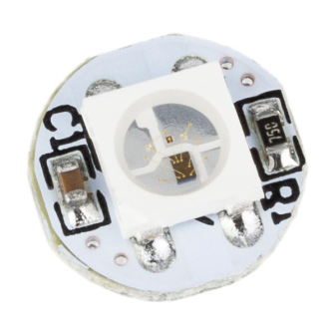
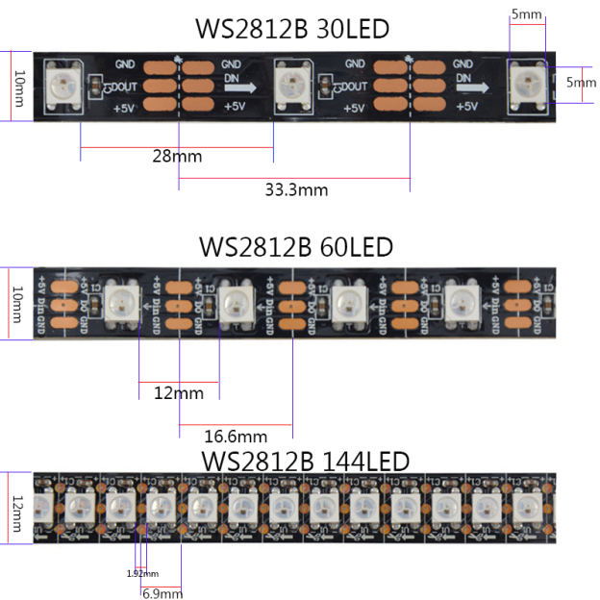
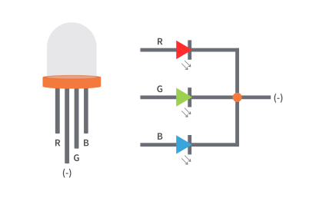
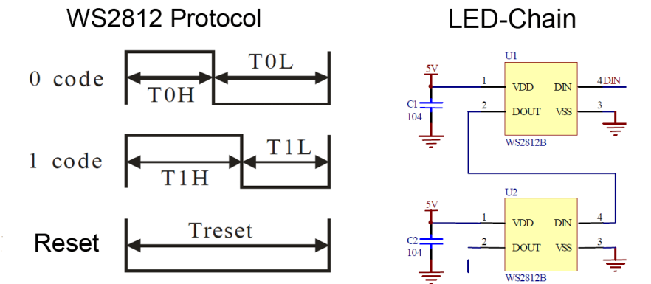
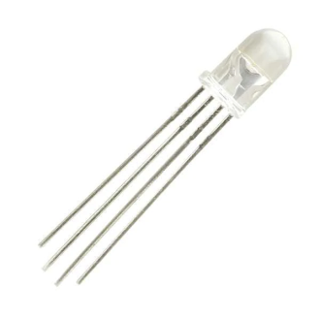
The WS2812B LED aka Neopixel
The WS2812B is an (integrated) chip and 5050 package (flat, square) RGB LED
An RGB LED can display 24 bits of color (0-255 red, 0-255 green, 0-255 blue)
There are RGB LED controllers other than the WS2812B; discussion of those is outside the scope of our class
“Neopixel” is a proprietary marketing term used by Adafruit Industries for their line of products based on the WS2812B
RGB LEDs, and their chipsets, can be designed to run at 5VDC and 12VDC
The chips of “Smart” LEDs make them individually controllable
Control is by means of a one-wire transmit-only serial data protocol; the signal is directional with an input and an output for each pixel. Usually daisy-chained.
This is the WS2812B chip
5050 RGB LED package
“Traditional” RGB LED
(5mm package)
Types of WS2812B Strips
PIXELS ARE DIRECTIONAL!!!

Slide 7
Different Voltage Requirements
Not all peripherals will run at the same voltage as the microprocessor board you are using
This results in different signal level tolerances. Not the power rails, but the control signals themselves operate at different voltages.
Transmitting a 5 volt signal into a 3.3 volt device will damage or destroy the receiving device. This is as true for SPI as it is for traditional RS-232C TTL serial connections.
Transmitting a 3 volt signal into a 5 volt device sometimes works. It depends on how well designed the receiving device is.
The best-practice solution to this problem is to use devices called level shifters. Level shifters provide voltage translation between the two different signal levels.

Slide 8
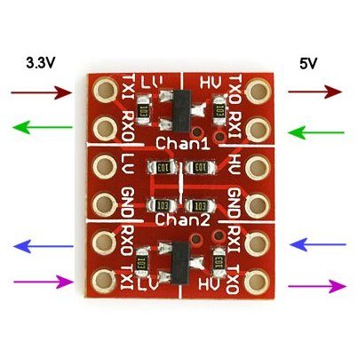
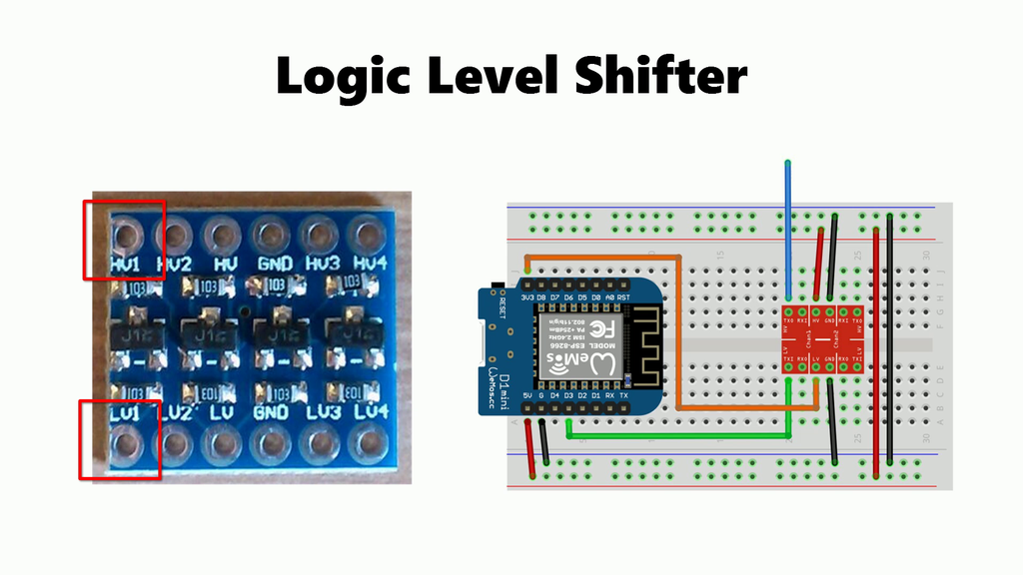
Level Shifters
Level shifters provide bidirectional translation of logical signal voltages between different digital peripherals and devices
For instance, if you needed to connect a 3.3V microcontroller to a 5V real time clock (RTC), you would use a level shifter on the SPI or I2C serial connections
Nearly all level shifters are for 5 VDC and 3.3VDC translation
Level shifters are not self powered; they must have external power connections to the higher voltage (5V) rail

Slide 9
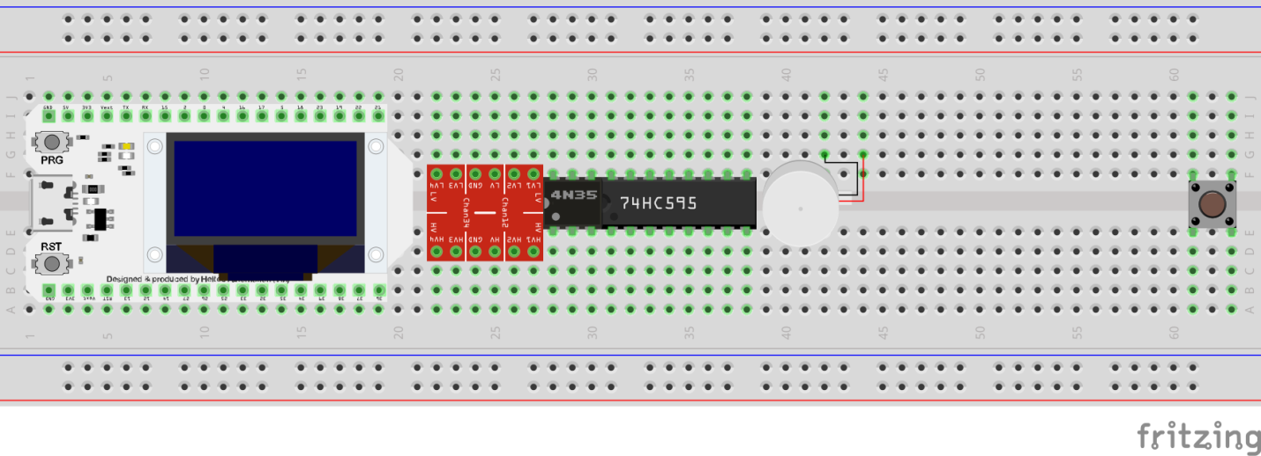
Adding A Level Shifter
Level shifters provide bidirectional translation of logical signal voltages between different digital peripherals and devices
Update your breadboard to look like the below image
Shift the 4N35 opto-isolator to the right if needed to make room for the level shifter next to the Heltec board
1) Move to the right ->
2) Install Level Shifter

Slide 10
Using a Level Shifter
Level shifters require connections from both 5VDC (“high voltage”) and 3V3 (“low voltage”)
3V3 is often taken direct from the microcontroller; we will do this
5VDC should come from the main 5V rail
Only a single ground connection to the level shifter is required
The microcontroller data out pin connects to an “LV” input of the level shifter
The “HV” output of the level shifter connects to the LED strip (or other 5VDC peripheral)
From Microcontroller
HV1 to DIN
From 3V3 (3.3 VDC)
From Circuit Ground
From 5VDC
From Circuit Ground

Slide 11
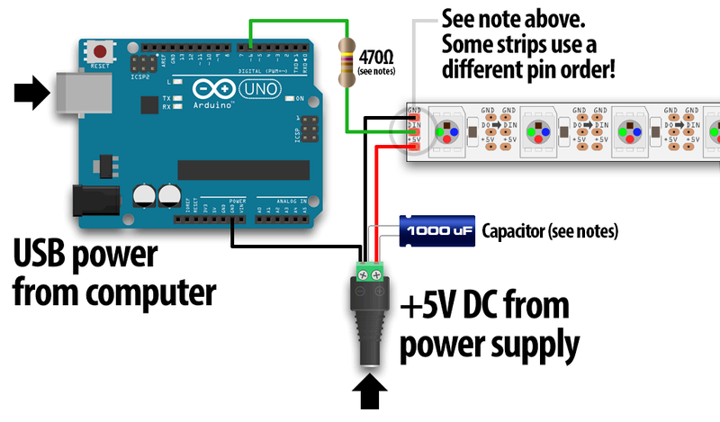
External Power and WS2812B Neopixels
RGB LEDs of any kind draw LOTS of current. 20mA per LED x 3 LEDs = 60 mA of current as a general power budget. THAT’S PER LED.
More than 5 Neopixels will overload most 500mA board power regulators.
The solution to this problem is to use external power for the LED strip.
When the external power is 12 or 5 volts and the microcontroller is 3 volts things get very tricky indeed
It’s OK to send 5V to the board input power pin and the LEDs simultaneously
It’s generally NOT OK to connect USB power at the same time
Level shifting may be required for the serial data line (Data IN) to the Neopixels. This is entirely dependent on the pixel type. YMMV!
The ability to SAFELY connect USB power and external power at the same time depends on the board!!!
Most boards will attempt to power peripheral devices using USB power
There is no sanity checking of this action
Trying to power numbers of Neopixels from any board will overload the onboard regulator

Slide 12
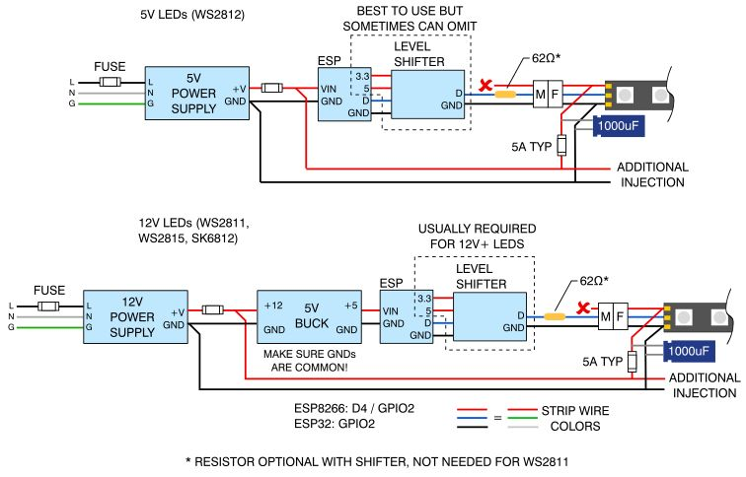
AN IMPORTANT NOTE ON FUSES!
Remember that lots of LEDs draw huge amounts of power!
For 2A or less, it’s OK to rely on your power supply to provide overcurrent and fault protection
For 3A or larger power supplies, always use a fuse!
Fuses keep magic smoke from becoming real fire!!
Place fuses in-line (in series) with positive rail immediately following your power supply positive output. Do this for all power supplies Three (3) Amps or larger!!!

Slide 13
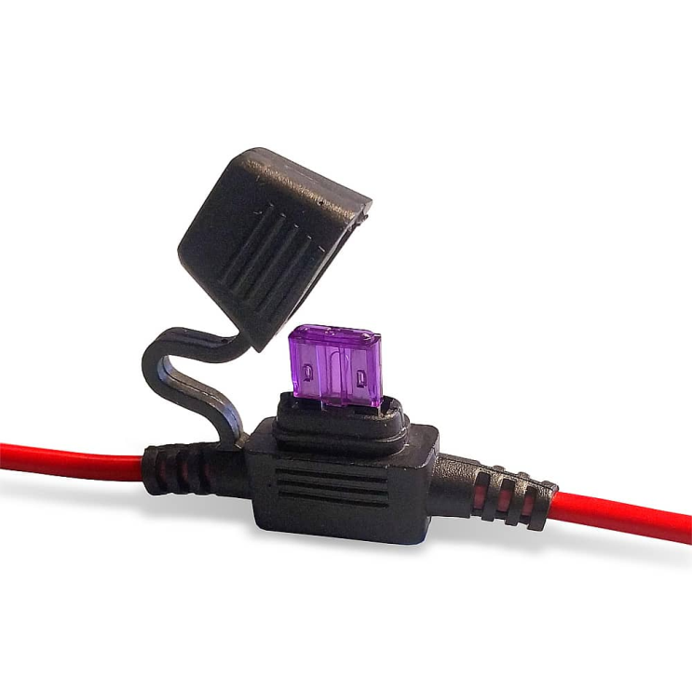
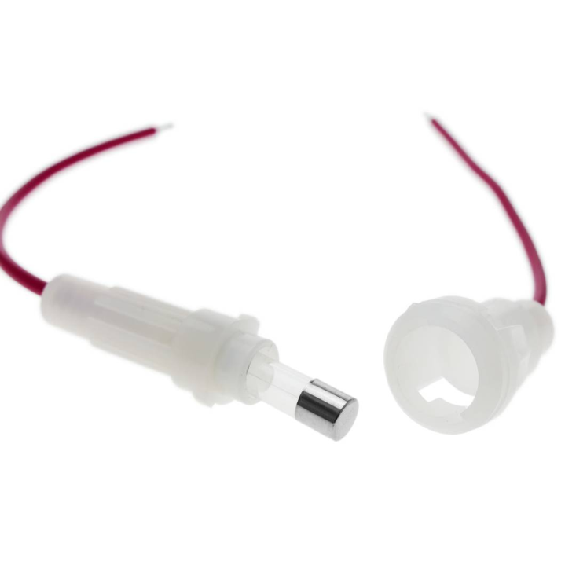
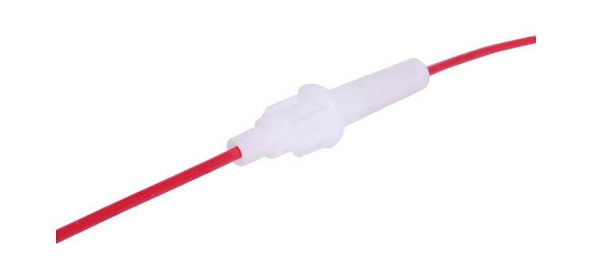
Typical in-line fuses for electronics
SCREW TYPE BUSS HOLDER
MINI BLADE FUSE HOLDER
Use mini, not full size, fuses for your projects. Both blade and glass/Buss fuses and fuse holders come in mini sizes.
Use a slightly larger fuse than your power supply rating, e.g., 5A fuse for 3A or 4A supply, 15A fuse for 10A supply, etc. Don’t massively oversize the fuse though (20A fuse on a 5A supply) as that defeats the purpose.

Slide 14
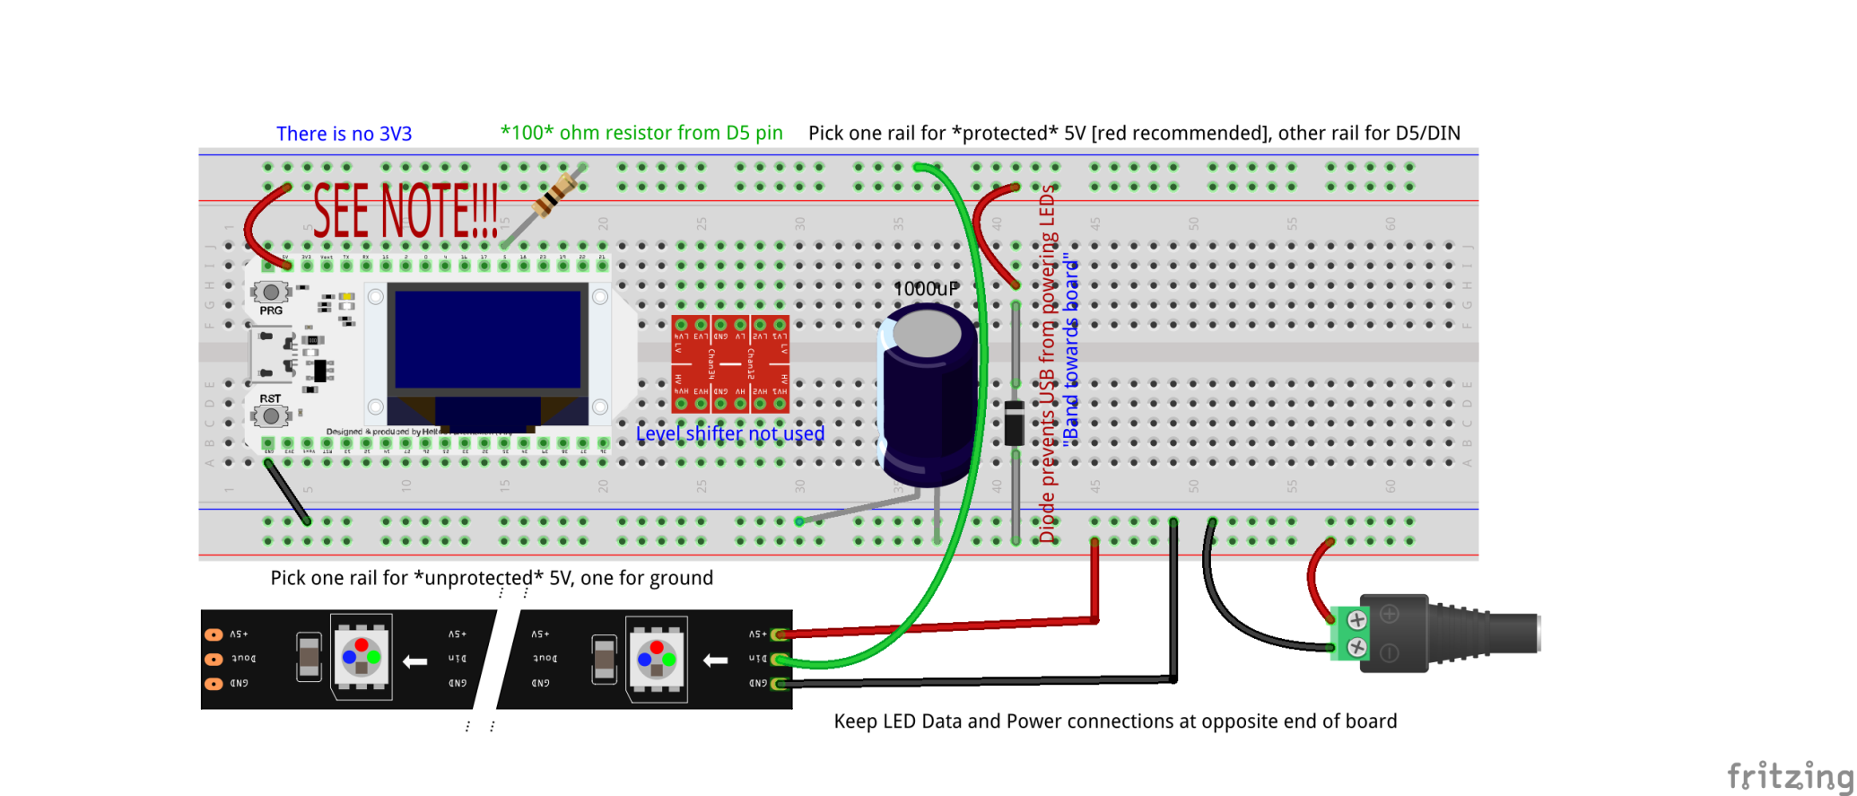
Wiring an ESP32 and Neopixels: 3.3 volt
From your Arduino kits:
Green power plug adapter
1000uF capacitor
100 ohm (brown-black-brown) resistor
WS2812B LED strip
One (1) general purpose diode
Male-Male DuPont jumpers as required
Wire your breadboard up to look like this:
Further research shows that in many cases a 100 ohm resistor is sufficient for coupling the microcontroller to the LED strip. The level shifter is not required. Unfortunately, this depends on microcontroller quality which varies greatly with our inexpensive units.
NEVER connect USB and external power without the in-line diode. Or else something will go terribly wrong.
Level shifter is NOT used or wired with this build!
The 1000uF capacitors are loose in the large plastic boxes in your kits
MIND THE POLARITY OF THESE!!!!
These are DuPont Male-Male jumper wires that connect directly from the breadboard rails to the mail LED strip connector and power plug.
Be 100% certain that you have not reversed the 5V and ground connections to the LED strip!
Ground wire on strips is WHITE, not BLACK.
JST connector not fully shown
Have your instructor check all work before applying power to anything!

Slide 15
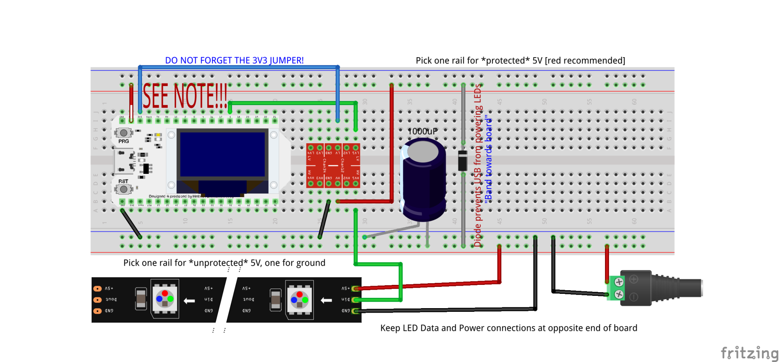
Wiring an ESP32 and Neopixels: Level Shift
From your Arduino kits:
Green power plug adapter
1000uF capacitor
WS2812B LED strip
One (1) general purpose diode
Male-Male DuPont jumpers as required
Wire your breadboard up to look like this:
In spite of extensive pre-testing of the design, it turns out that our LED strips are an off-brand that will probably not operate without level shifters. These will be preinstalled in kits or supplied in class.
NEVER connect USB and external power without the in-line diode. Or else something will go terribly wrong.
3V3 connects to “LV” pin/bus
HV connects to protected 5V power
The 1000uF capacitors are loose in the large plastic boxes in your kits
MIND THE POLARITY OF THESE!!!!
These are DuPont Male-Male jumper wires that connect directly from the breadboard rails to the mail LED strip connector and power plug.
Be 100% certain that you have not reversed the 5V and ground connections to the LED strip!
Ground wire on strips is WHITE, not BLACK.
JST connector not fully shown
Have your instructor check all work before applying power to anything!

Slide 16
The FastLED Library
Find the Arduino sketch in your Lesson 9 folder (which you copied from your USB drives, right?) named “ClassSketch3-V2” and open it in the Arduino IDE (double clicking the [.ino] file is easiest)
Open the Library manager (Tools-Manage Libraries)
Search for the FastLED Library
Install the latest version
Close the Library manager when done
Search for FastLED
Install it
This one!

Slide 17
Let There Be Light Redux
https://install.wled.me/
Connect your board to your laptop using USB cable (board end first, then the laptop end!) LEAVE EXTERNAL 5V POWER DISCONNECTED!!!
Remember to set your board type and port speed! (Change speed if initial upload fails!)
Upload the sketch! ➔ (this also validates it first)
Disconnect USB!!!
Connect the external 5VDC power supply
Did it work? Enjoy the light show!☺
It didn’t work? Now we get to troubleshoot!🔧😎
See what happens if you change “RAINBOW true” to “RAINBOW false” in your sketch. Remember to reupload after modifications!

Slide 18
Anatomy of a sketch
#include <FastLED.h>
// How many leds in your strip?
#define NUM_LEDS 30
// Which pin is the pixel DIN line connected to?
#define DATA_PIN 5
#define LED_TYPE WS2812B
#define COLOR_ORDER GRB
#define BRIGHTNESS 30
#define RAINBOW true
Setup()
{
delay(3000);
FastLED.addLeds<LED_TYPE, DATA_PIN, COLOR_ORDER>(leds, NUM_LEDS); FastLED.setBrightness(BRIGHTNESS);
}
void loop()
{
if (RAINBOW)
{
fill_rainbow(leds,NUM_LEDS,i++,1);
FastLED.show();
}
…
FastLED library must be installed with Library Manager before it can be included in the sketch
These #define’s are actually macro definitions, and not variable declarations. Macros are substituted wherever they appear. More on that next semester– or see The Arduino Cookbook.
Setup section excerpt
Loop section excerpt
What happens if you change the RAINBOW def to false?

Slide 19
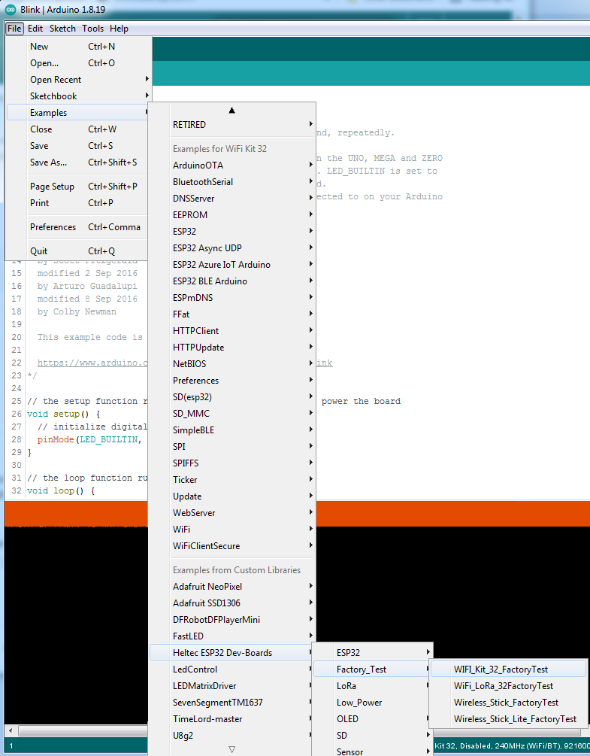
WiFi Operation Test
Due to the numerous manufacturer defects in our off-brand Heltec boards, we are going to validate WiFi operation before moving forwards. Anyone with a board having defective WiFi will receive a Wemos D1 mini controller to complete the class with.
Connect your Heltec board
Find the WiFi_Kit_32_FactoryTest example sketch under Heltec ESP32 DevBoards sub-menu
After checking your port and port speed settings, click the upload button
You should see at least one wifi network listed once the board reboots and fails its initial connection attempt.

Slide 20
Flashing Software Binaries
The Arduino IDE takes Processing/C++ source code and compiles it into a single binary file which is then transmitted to the microcontroller where it is stored in flash memory
Uploading of binary executable files to a microcontroller is called “flashing”
It is possible to obtain precompiled binaries and flash them without having source code or using the Arduino IDE
This is very, very similar to installing an app on a phone (and is identical to initially installing the operating system onto a phone, which is done at the factory)
There is extremely sophisticated smart LED strip control software called WLED which is specially made to be flashed to ESP8266 and ESP32 chipsets. And we will do this.

Slide 21
Flashing WLED Software on ESP32 3 Different methods based on OS
Kubuntu Linux Install and use esptool (uses Konsole CLI)
Windows (with current version of Chrome) https://install.wled.me/
Windows (if online browser install doesn’t work) Install Python3 and use esptool.py

Slide 22
Flashing WLED Software on Linux
Copy these software binary files from your flash drive to your Documents folder (use the Dolphin GUI file explorer) esp32_bootloader_v4 WLED_0.13.1_ESP32
Open a Konsole window, and enter the following commands (enter your account password when/if prompted) sudo apt install esptool cd Documents esptool --port /dev/ttyUSB0 write_flash 0x0 ./esp32_bootloader_v4.bin esptool --port /dev/ttyUSB0 write_flash 0x10000 ./WLED_0.13.1_ESP32.bin

Slide 23
WLED: Windows with Chrome
Go to https://install.wled.me/ in Chrome
Click install and do the logical thing at the prompts. See below for details
Click on Install
Click on Connect
Click on INSTALL WLED
Click on INSTALL (once more)
All done!
Wait a while…

Slide 24
WLED: Windows with Python3
If the browser install doesn’t work on your Windows workstation, you’ll need to install Python3 and then install esptool.py
Copy these software binary files from your flash drive to your Documents folder esp32_bootloader_v4 WLED_0.13.1_ESP32
For Windows 10/11, run the python-3.10.4-amd64 installer (copy it from your flash drive FIRST!)
For Windows 7/8, run the python-3.8.10-amd64 installer (copy it from your flash drive FIRST!)
Once Python is installed, open a CMD (DOS CLI) window
Enter the following commands into the DOS CLI prompt (you can skip the REM comments): pip install esptool REM Change to the directory you copied the WLED binaries to cd %userprofile%\Documents REM Connect your board and find the port it’s on with Device Mgr (dnu “??”) REM Then flash the bootloader first esptool.py --port COM?? write_flash 0x0 ./esp32_bootloader_v4.bin REM Then flash the WLED software itself esptool.py --port COM?? write_flash 0x10000 ./WLED_0.13.1_ESP32.bin

Slide 25
WLED – LED PINS
WLED is configured to use certain hardware defaults for the ESP-32 processor
You will need to either change the GPIO pin used to DIN to your LED strip, or update the GPIO pin in the settings dialog on the web UI
Either will work!
WLED IS SET TO USE GPIO16 BY DEFAULT.
MOVE LED DATA DIN JUMPER TO THIS PIN TO RECONFIGURE BOARD
WE USE GPIO5 FOR SKETCH#3; THIS IS HOW YOUR BOARD IS WIRED NOW
YOU MUST EITHER MOVE THE DIN JUMPER TO GPIO16 OR UPDATE THE SOFTWARE SETTING!

Slide 26
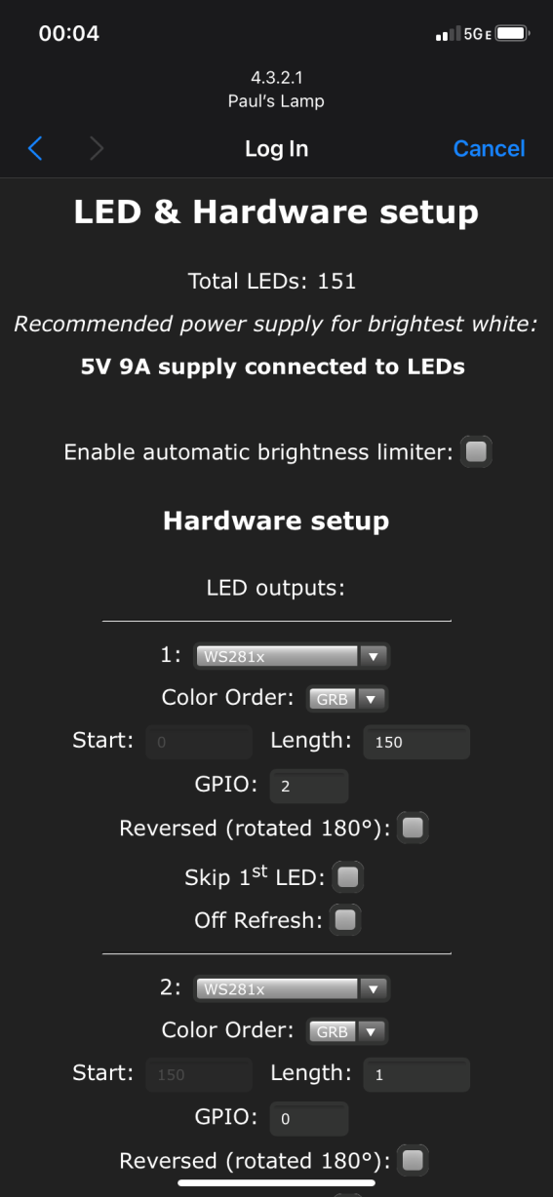
WLED – GPIO SETTING
WLED is configured to use certain hardware defaults for the ESP-32 processor
You can change the GPIO pin used for the LED DIN data line in the LED settings screen (Configuration->LED Settings)
Beware that GPIO pins may be named differently on different boards! Always verify using the pinout diagram for your board!
Enabling automatic brightness limiting is highly recommended with your 2A power supplies!
Note: Nearly all strips are WS281x
This setting must match the GPIO pin that the DIN data line to the LED strip is connected to!
Modify your LED settings screen to match the above if you want to use the existing class configuration of GPIO5

Slide 27
WLED – Getting Started
Introductory instructions are at https://kno.wled.ge/basics/getting-started/
Default WiFi SSID on startup is WLED-AP
Default WiFi password is wled1234
Once you connect, you should automagically be taken to the main WLED page on your ESP32
Click on “WIFI SETTINGS”; Change “AP SSID” and “AP password” to personalize your WLED controller; “Save and Connect” DO NOT connect your controller to a local wifi net at this time!
Reconnect to your new ESP32 lamp controller, and check out the zillion and one options!

Slide 28
WLED – Going Further
WLED is designed to be connected to a WiFi network. Once you configure the software to connect to WiFi, you will need the Android or iOS phone application WLED in order to reach the controller!
You can also reach the controller at the IP address assigned to it by your WiFi network, but figuring out what that assigned IP address is can be tricky. Best use the phone app instead.
Once connected to WiFi, you can enable Internet time sync which lets you configure schedules etc.
There is a wealth of awesome information and ideas at https://kno.wled.ge/basics/tutorials/

Slide 29
ESP8266 Addenda
Since we have just used up all the spare microcontrollers due to recent failures and factory defects, any boards which fail the WiFi check will be replaced with inexpensive ESP8266 boards. Here is information on that board for your reference, duplicated to your flash drives.
wemos D1 Mini Pinout
WS2812 Breadboard diagram for wemos D1
Flashing WLED software on ESP8266

Slide 30
wemos D1 Mini and Pinout
Microcontroller | ESP8266
Processor | Tensilica Xtensa Diamond 32-bit
Operating Voltage | 3.3V
Minimum Operating Voltage | 2.58V
Maximum Operating Voltage | 3.6V
Arduino IDE Board | LOLIN(WEMOS) D1 R2 & mini
Power Supply via VIN,VCC | 4V...6V
VIN,VCC output USB power supply | 4.67V
Digital I/O Pins (with PWM) | 11 (11)
Analog Input Pins | 1
Resolution ADC | 10 bit (0...1023)
Analog Output Pins | 0
SPI/I2C/I2S/UART | 1/1/1/1
Max DC Current per I/O Pin | 12 mA
Flash Memory | 4 MB
SRAM | 64 KB
EEPROM | 512 bytes
Clock Speed | 80/160 MHz
Length x Width | 34mm x 26mm
Fits on standard breadboard | yes
WIFI | IEEE 802.11 b/g/n
Bluetooth | no
Touch sensor | no
CAN | no
Ethernet MAC Interface | no
Temperature Sensor | no
Hall effect sensor | no
Power jack | no
USB connection | yes
Battery Connection | no
Programmable | Arduino IDE, LuaNode SDK, Micropython
3.3V Voltage Regulator | ME6211
Output Voltage | 3.3V
Maximum Input Voltage | 6V
Minimum Input Voltage | 4.3V
Maximum Output Current | 500mA
Hilights
11 digital IO, interrupt/pwm/I2C/one-wire supported(except D0)
1 analog input(3.2V max input)
Micro USB or Type-C USB Port (clones usually have micro USB)
LOLIN I2C Port
Compatible with MicroPython, Arduino, nodemcu
Uses the CH340 USB-to-serial driver (installation usually needed on Windows)
WLED default button is GPIO0 (pin D2)
WLED default LED data is GPIO2 (pin D4)

Slide 31
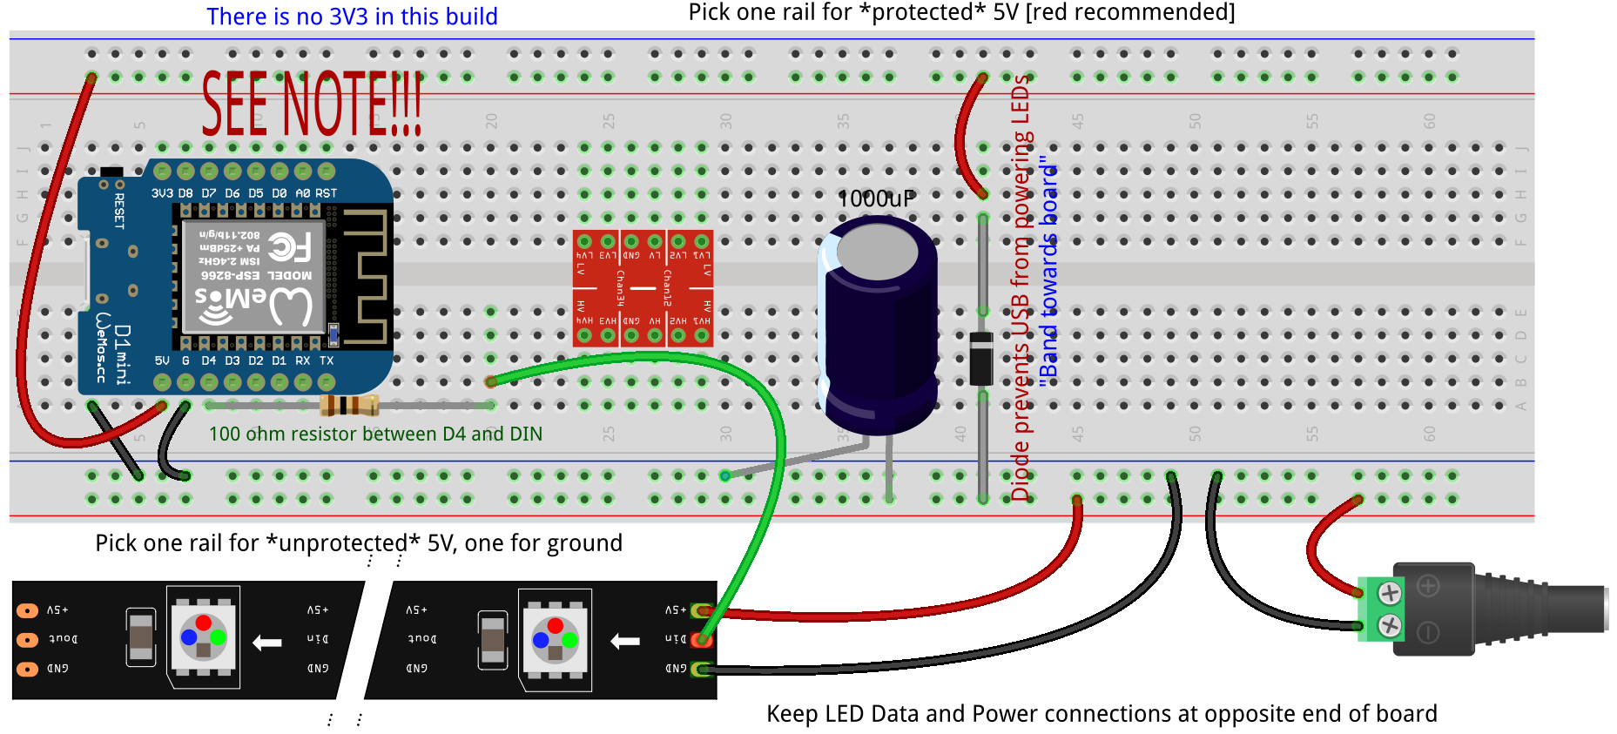
Wiring a D1 Mini and Neopixels – 3.3 Volt
From your Arduino kits:
Green power plug adapter
1000uF capacitor
100 ohm resistor (brown-black-brown)
WS2812B LED strip
One (1) general purpose diode
Male-Male DuPont jumpers as required
Wire your breadboard up to look like this:
Use this diagram if you have been given a D1 Mini ESP8266 board instead of a Heltec ESP32 board
In most cases, level shifters are not required, only 100 ohm resistors to couple the D4 pin in on the ESP8266 to the DIN pin on the LED strip
NEVER connect USB and external power without the in-line diode. Or else something will go terribly wrong.
Level shifter is NOT used or wired with this build!
The 1000uF capacitors are loose in the large plastic boxes in your kits
MIND THE POLARITY OF THESE!!!!
These are DuPont Male-Male jumper wires that connect directly from the breadboard rails to the mail LED strip connector and power plug.
Be 100% certain that you have not reversed the 5V and ground connections to the LED strip!
Ground wire on strip JST connectors is WHITE, not BLACK.
JST connector not fully shown
Have your instructor check all work before applying power to anything!

Slide 32
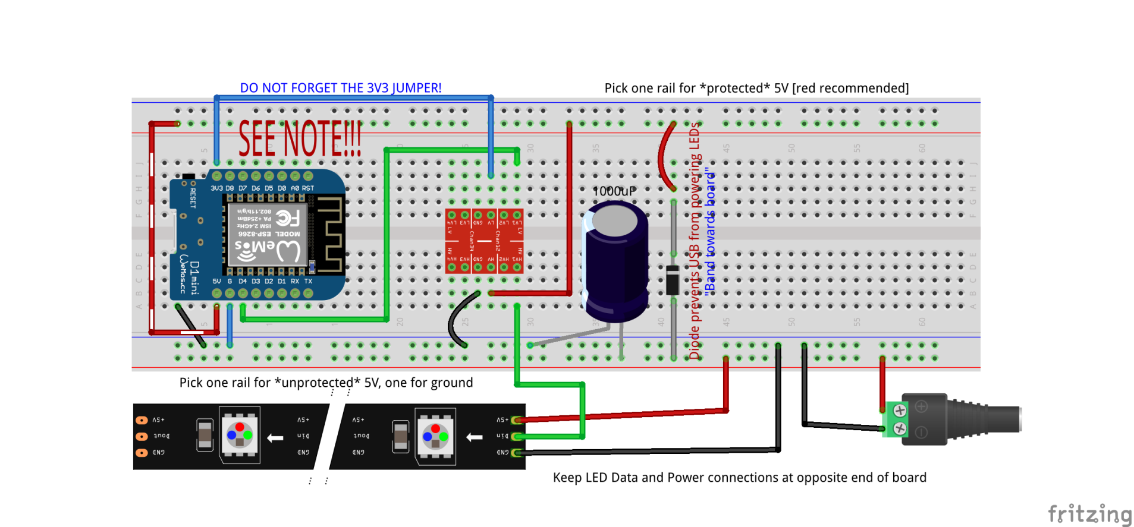
Wiring a D1 Mini and Neopixels – Level Shift
From your Arduino kits:
Green power plug adapter
1000uF capacitor
WS2812B LED strip
One (1) general purpose diode
Male-Male DuPont jumpers as required
Wire your breadboard up to look like this:
Use this diagram if you have been given a D1 Mini ESP8266 board instead of a Heltec ESP32 board
In spite of extensive pre-testing of the design, it turns out that our LED strips are an off-brand that will not operate without level shifters. These will be preinstalled in kits or supplied in class.
NEVER connect USB and external power without the in-line diode. Or else something will go terribly wrong.
3V3 connects to “LV” pin/bus
HV connects to protected 5V power
The 1000uF capacitors are loose in the large plastic boxes in your kits
MIND THE POLARITY OF THESE!!!!
These are DuPont Male-Male jumper wires that connect directly from the breadboard rails to the mail LED strip connector and power plug.
Be 100% certain that you have not reversed the 5V and ground connections to the LED strip!
Ground wire on strip JST connectors is WHITE, not BLACK.
JST connector not fully shown
Have your instructor check all work before applying power to anything!

Slide 33
Flashing WLED Software on ESP8266 3 Different Methods based on OS
Kubuntu Linux Install and use esptool (uses Konsole CLI)
Windows (with current version of Chrome) https://install.wled.me/
Windows (if online browser install doesn’t work) Install Python3 and use esptool.py

Slide 34
Flashing ESP8266 Software on Linux
Copy these software binary files from your flash drive to your Documents folder (use the Dolphin GUI file explorer) WLED_0.13.1_ESP8266
Open a Konsole window, and enter the following commands (enter your account password when/if prompted) sudo apt install esptool cd Documents esptool --port /dev/ttyUSB0 write_flash 0x0 WLED_0.13.1_ESP8266

Slide 35
WLED ESP8266: Windows with Chrome
Go to https://install.wled.me/ in Chrome
Click install and do the logical thing at the prompts. See below for details
Click on Install
Click on Connect
Click on INSTALL WLED
Click on INSTALL (once more)
All done!
Wait a while…

Slide 36
WLED ESP8266: Windows with Python3
If the browser install doesn’t work on your Windows workstation, you’ll need to install Python3 and then install esptool.py
Copy these software binary files from your flash drive to your Documents folder WLED_0.13.1_ESP8266
For Windows 10/11, run the python-3.10.4-amd64 installer (copy it from your flash drive FIRST!)
For Windows 7/8, run the python-3.8.10-amd64 installer (copy it from your flash drive FIRST!)
Once Python is installed, open a CMD (DOS CLI) window
Enter the following commands into the DOS CLI prompt (you can skip the REM comments): pip install esptool REM Change to the directory you copied the WLED binaries to cd %userprofile%\Documents REM Connect your board and find the port it’s on with Device Mgr REM Then flash the WLED software esptool.py --port COM?? write_flash 0x0 ./WLED_0.13.1_ESP8266

Slide 37
WLED – Getting Started
Introductory instructions are at https://kno.wled.ge/basics/getting-started/
Default WiFi SSID on startup is WLED-AP
Default WiFi password is wled1234
Once you connect, you should automagically be taken to the main WLED page on your ESP8266
Click on “WIFI SETTINGS”; Change “AP SSID” and “AP password” to personalize your WLED controller; “Save and Connect” [DO NOT connect your controller to a local wifi net at this time!]
Reconnect to your new ESP8266 lamp controller, and check out the zillion and one options!

Slide 38
Formal End of Lesson 10-11-12
AND THAT’S THE END OF THIS CLASS!
Arduino Programming will be offered in Fall of 2022. Hope to see you all there!
Note: There are no prerequisite classes for Arduino Programming. All students will be supplied with a prewired ESP8266 microcontroller and LED matrix display for use during the class.
Remember to keep your kits and USB drives!

